Slide 1


Introduction to Machine Learning Day 1
Sammie Omranian
June 2025

Slide 2

About instructor
Sammie Omranian
PhD Candidate in Biomedical and Health Informatics
Research area: Applications of Natural Language Processing in Healthcare
Experience: AI Researcher in Healthcare settings
LinkedIn Profile

Slide 3
Ice Breaker ML Bingo

Slide 4
When you know the foundation of ML Your Limit Is the Sky
Why Learn Regression in the Age of AI?

Slide 5
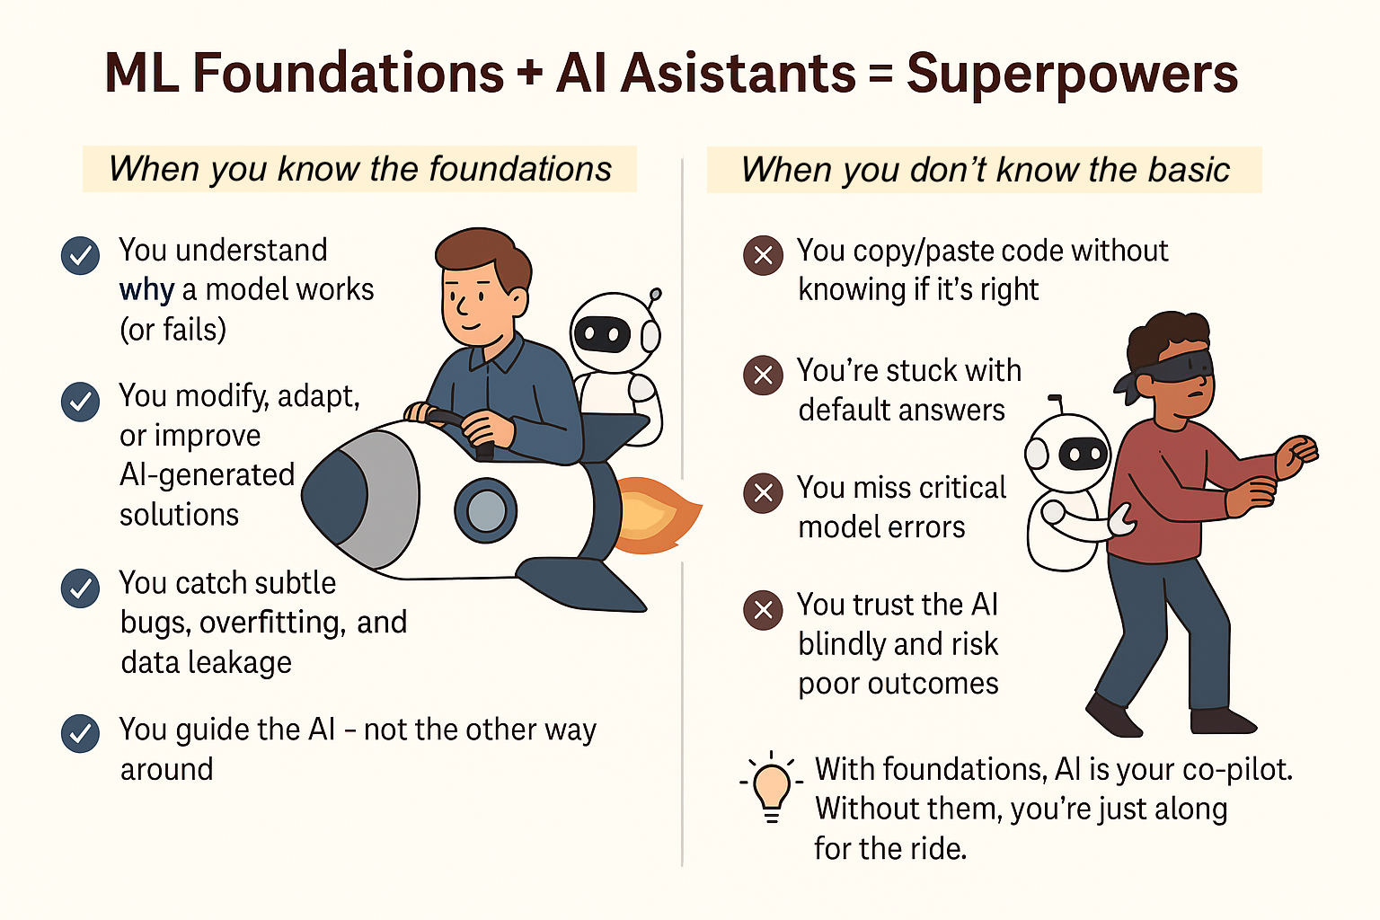

Slide 6
Terminology Used in This Course
Observation
A single unit in our level of observation—for example, a person, a sale, or a record.
Learning algorithms
An algorithm used to learn the best parameters of a model—for example, linear regression, naive Bayes, or decision trees.
Models
An output of a learning algorithm’s training. Learning algorithms train models, which we then use to make predictions.
Parameters
The weights or coefficients of a model learned through training.
Hyperparameters
The settings of a learning algorithm that need to be set before training.

Slide 7
Terminology Used in This Course
Performance
A metric used to evaluate a model.
Loss
A metric to maximize or minimize through training.
Train
Applying a learning algorithm to data using numerical approaches like gradient descent.
Fit
Applying a learning algorithm to data using analytical approaches.
Data
A collection of observations.

Slide 8
Definition
Arthur Samuel (1959), an American pioneer in the field of artificial intelligence, defined machine learning as:
The field of study that gives computers the ability to learn without being explicitly programmed.
He developed the checkers-playing program, in the late 1950s, one of his most notable achievements in the field of artificial intelligence and machine learning.

Slide 9
Definition
Tom Mitchell, a renowned computer scientist, defined machine learning as:
"A computer program is said to learn from experience E with respect to some task T and some performance measure P if its performance on T, as measured by P, improves with experience E."

Slide 10
Machine Learning Algorithms
Learning Algorithms
Supervised Learning
Unsupervised Learning
Reinforcement Learning

Slide 11
Introduction to Machine Learning
Types of ML:
- Supervised Learning: Learning from labeled data (e.g., classifying emails as spam or not spam).
- Unsupervised Learning: Finding patterns in unlabeled data (e.g., clustering customers based on purchasing behavior).
- Reinforcement Learning: Learning by interacting with an environment to maximize cumulative reward (e.g., training a robot to walk).

Slide 12
Introduction to Machine Learning
Applications:
- Healthcare (predicting diseases)
- Finance (fraud detection)
- Marketing (customer segmentation)
- Autonomous vehicles (self-driving cars)

Slide 13
Introduction to Machine Learning
Workflow:
Data Collection
Data Preprocessing
Model Training
Model Evaluation
Model Deployment

Slide 14
Supervised Learning
Regression
Classification

Slide 15
Supervised Learning
Regression vs Classification:
- Regression: Predicting continuous values (e.g., house prices).
- Classification: Predicting categorical values (e.g., whether a tumor is benign or malignant).

Slide 16
Supervised Learning
Regression vs Classification:
Can you think of examples from your field that are regression vs classification?

Slide 17
Supervised Learning
Key Concepts:
- Features: Independent variables used as input.
- Labels: Dependent variables (target) we want to predict.
- Training Set: Subset of data used to train the model.
- Test Set: Subset of data used to evaluate the model's performance.

Slide 18
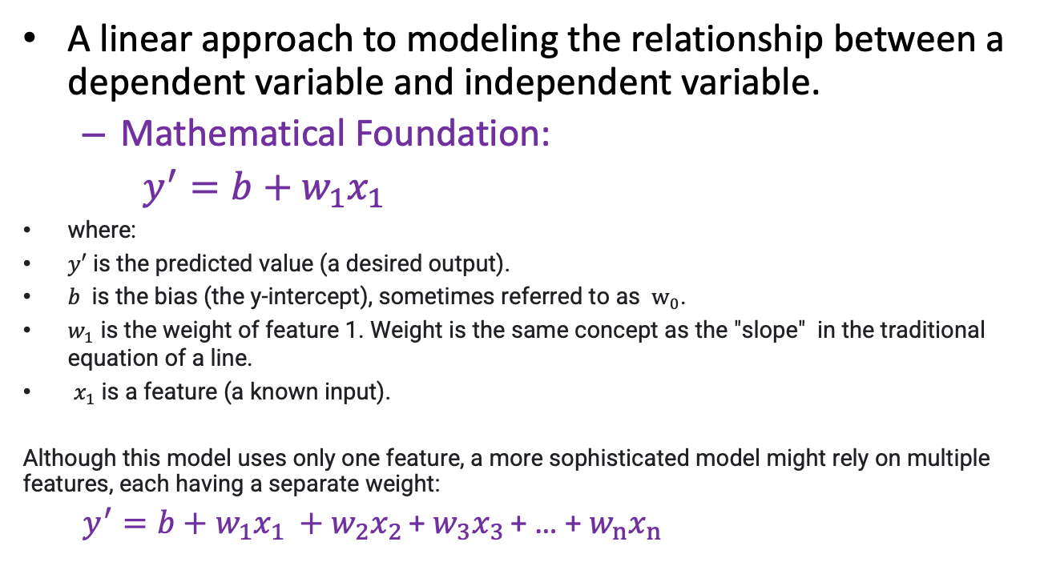
Linear Regression
A linear approach to modeling the relationship between a dependent variable and independent variable.
Mathematical Foundation:
$y^{′}=b+w_{1}x_{1}$
where:
$y′$ is the predicted value (a desired output).
$b$ is the bias (the y-intercept), sometimes referred to as $w_{0}$.
$w_{1}$ is the weight of feature 1. Weight is the same concept as the "slope" in the traditional equation of a line.
$x_{1}$is a feature (a known input).
Although this model uses only one feature, a more sophisticated model might rely on multiple features, each having a separate weight:
$y^{′}=b+w_{1}x_{1 }+w_{2}x_{2 }$+ $w_{3}x_{3 }$+ … + $w_{n}x_{n }$
Notes:
Linear regression is one of the most fundamental algorithms in machine learning. It models a straight-line relationship between an input variable — or feature — and an output, which is what we're trying to predict.
The formula shown here is the core idea: y′ = b + w₁x₁ where:
x₁ is our input (e.g., number of hours studied),
w₁ is the weight or slope (how much change in x affects y),
and b is the bias or intercept (where the line starts).
In practice, we usually have multiple features, so we expand this to include more terms like w₂x₂, w₃x₃, etc. — each feature has its own weight, and the model learns all of them during training.
This simple equation is powerful. It's the basis for many more complex models — and it’s interpretable, which is why it's still widely used in fields like economics, healthcare, and social sciences.

Slide 19
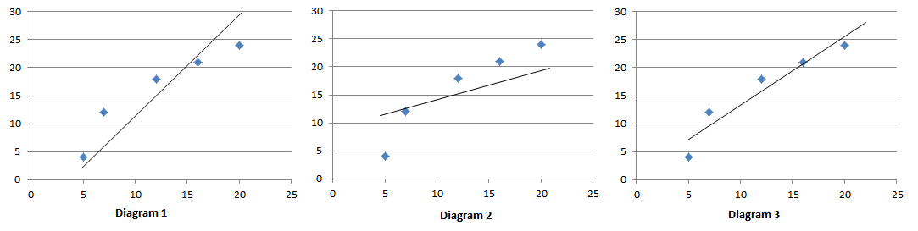
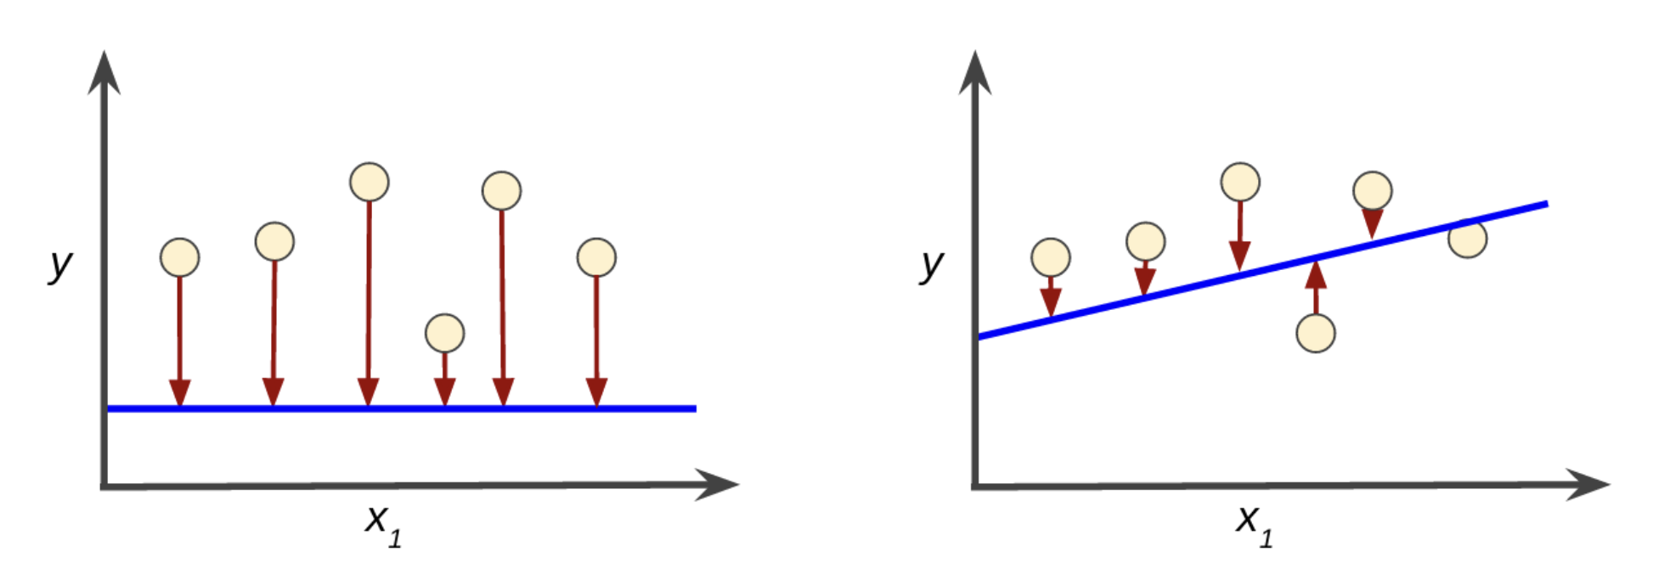
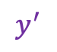
Simple Linear Regression
$$y^{′}$$
High error (difference between actual value and predicted value) in the left model; low error in the right model.
Notes:
This slide helps us visualize how well different regression models fit the data — and why minimizing error is so important in linear regression.
In the top row, we see three regression lines over the same dataset:
Diagram 1 shows a model that overestimates the slope — it's too steep.
Diagram 2 underestimates the slope — it's too flat.
Diagram 3 is a much better fit — it more closely follows the pattern of the data points.
In the bottom row, we zoom in on what we mean by error.
On the left, the predicted line (in blue) is flat — but the true values (circles) are far from it. The vertical arrows represent the errors — large differences between prediction and actual values.
On the right, the line better matches the data. The errors are smaller, which means the model is doing a better job.
Our goal in training a regression model is to minimize these errors — typically by minimizing something called the Mean Squared Error (MSE), which we’ll discuss shortly.

Slide 20
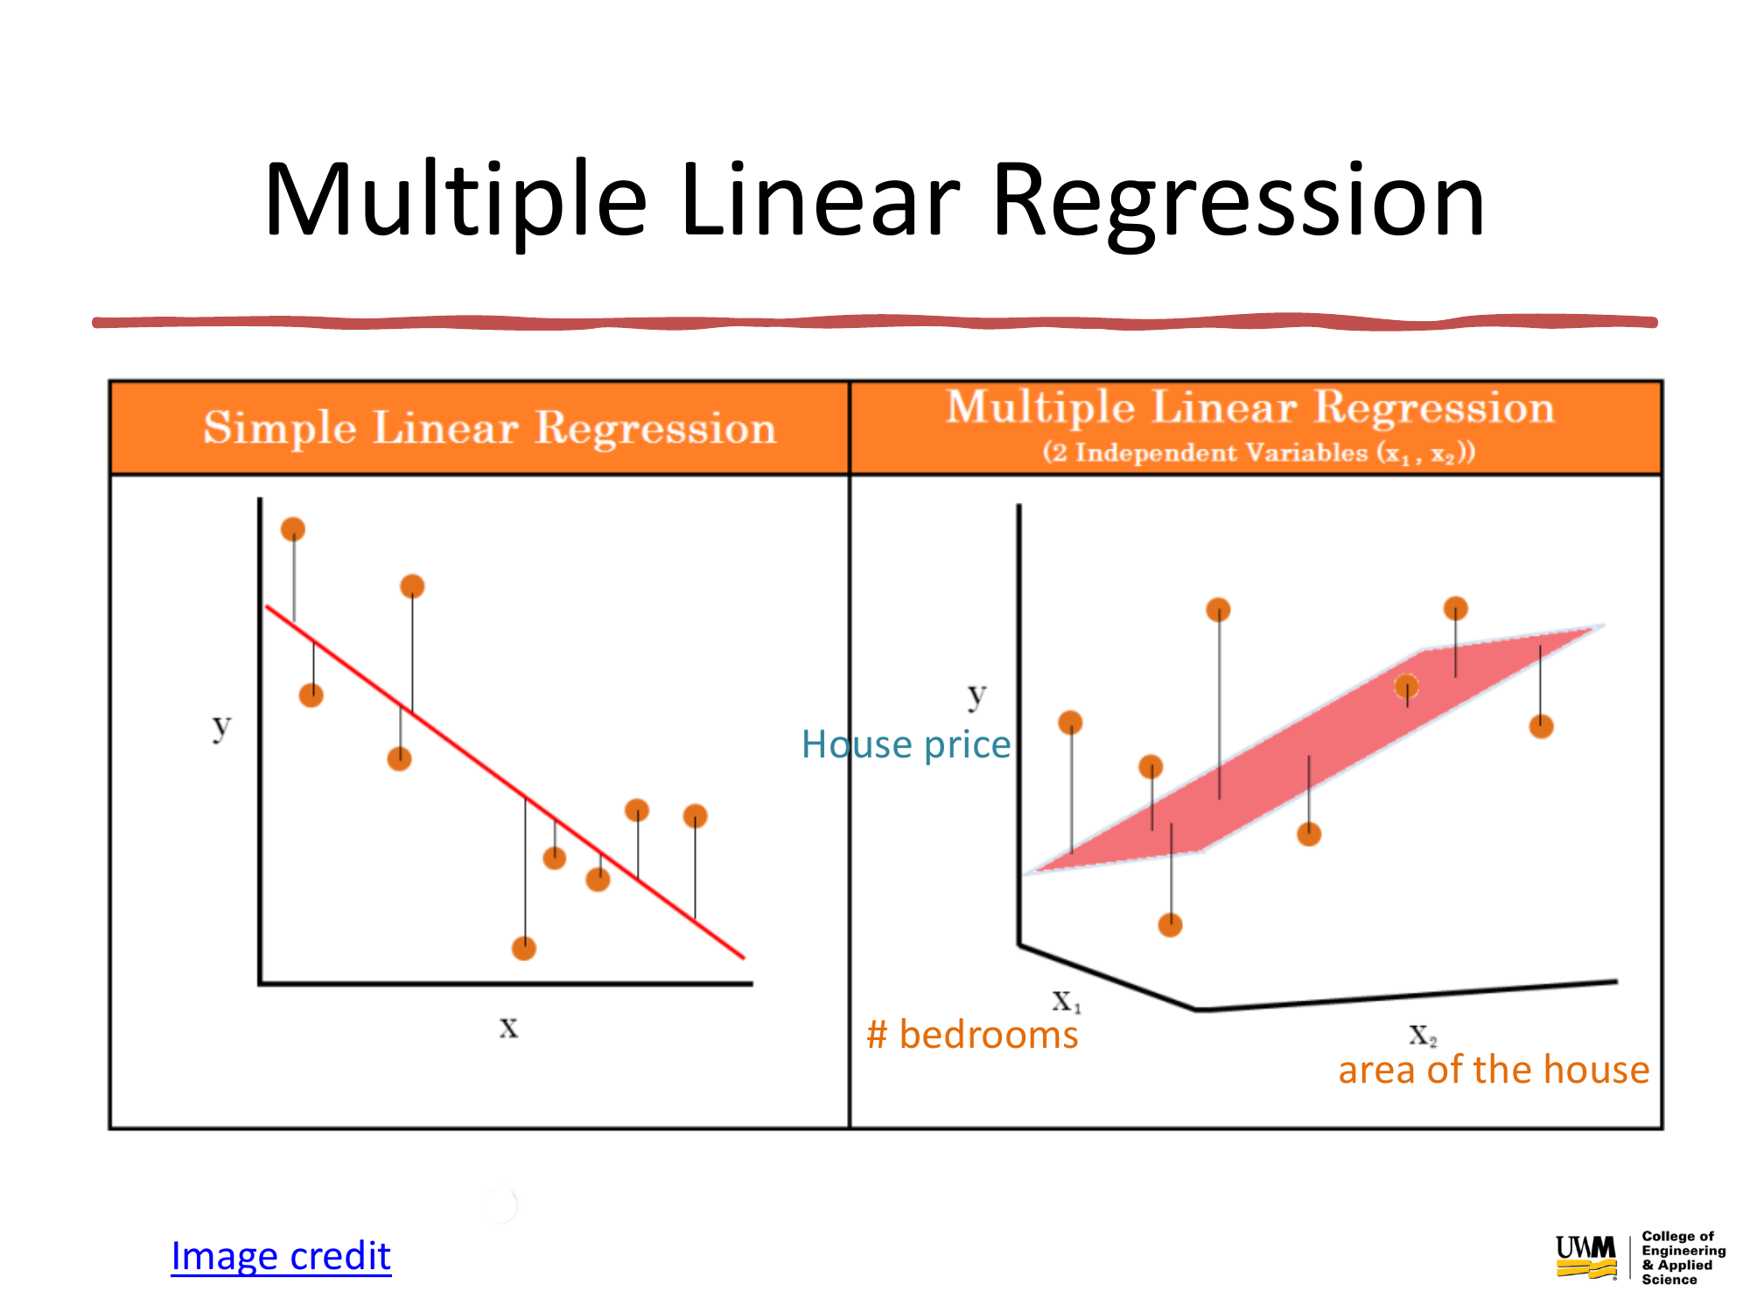


Image credit

Slide 21
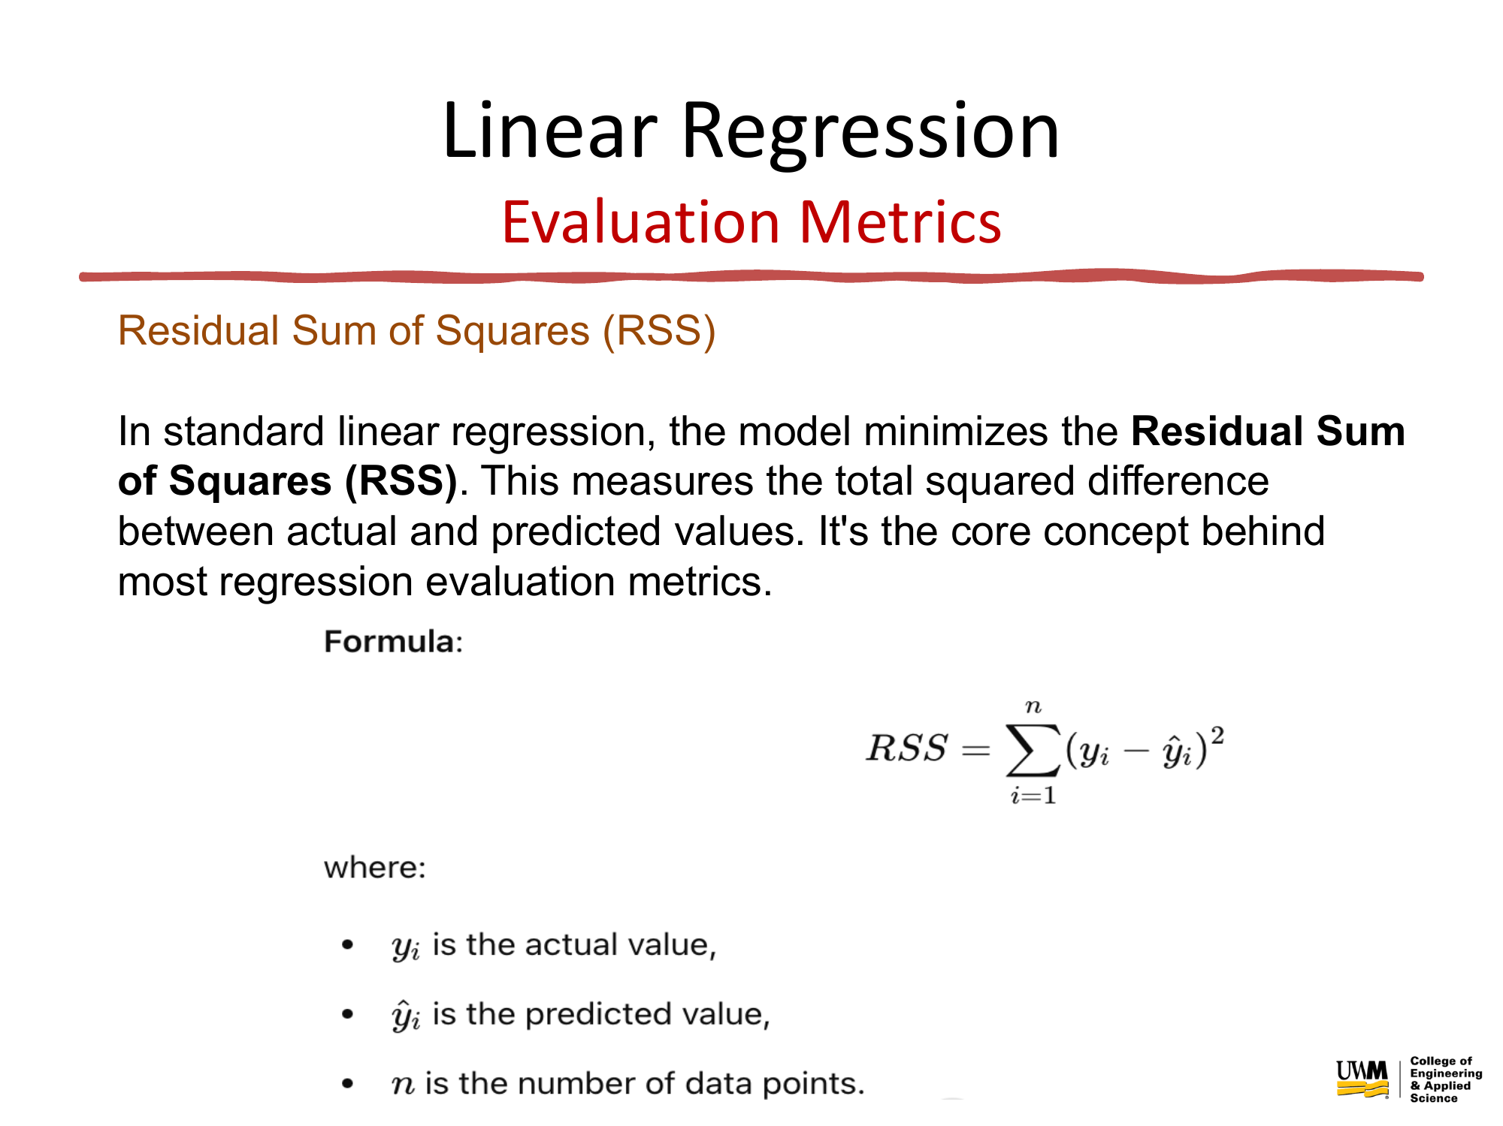


Slide 22
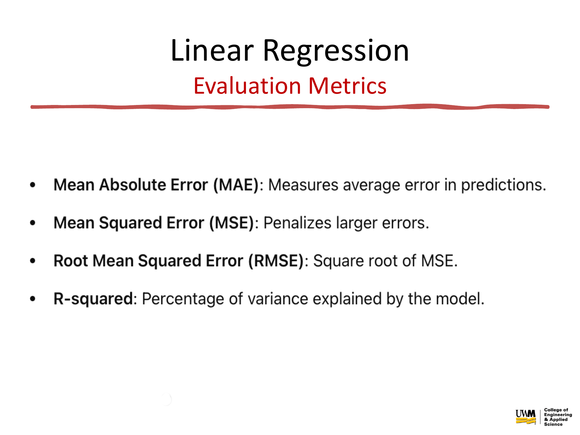


Slide 23
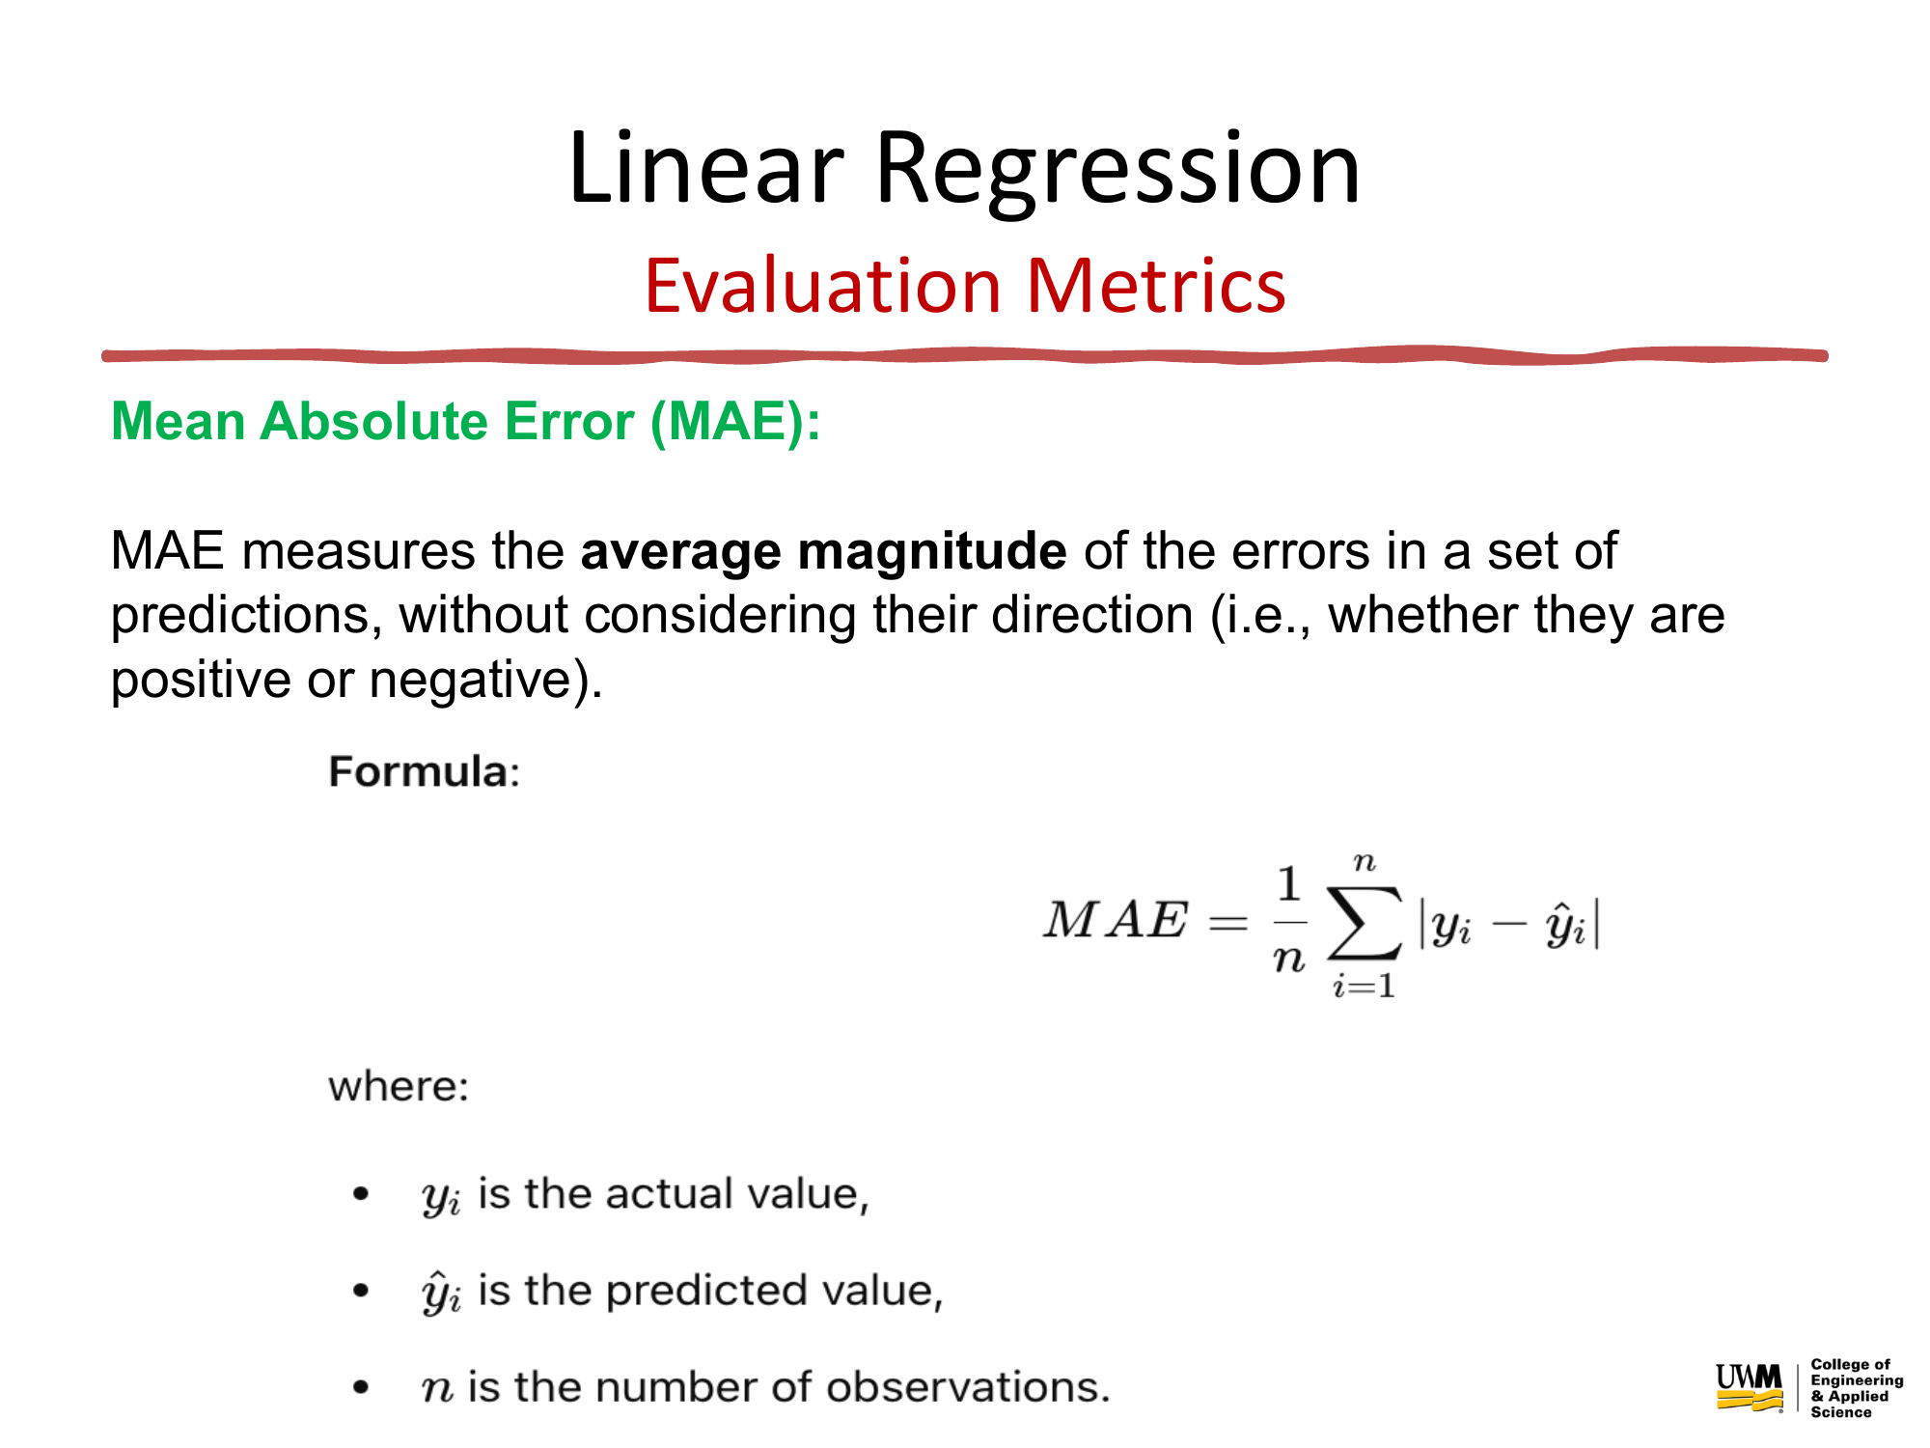


Slide 24
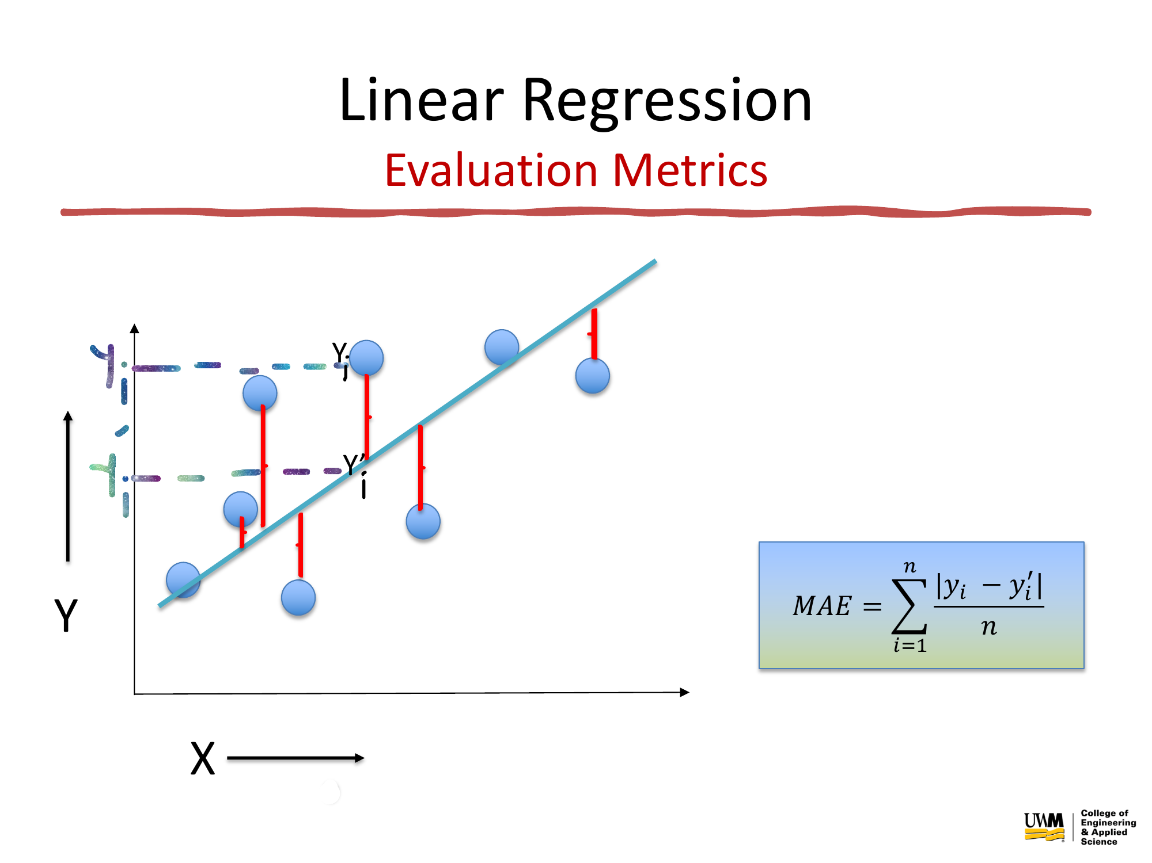


Slide 25
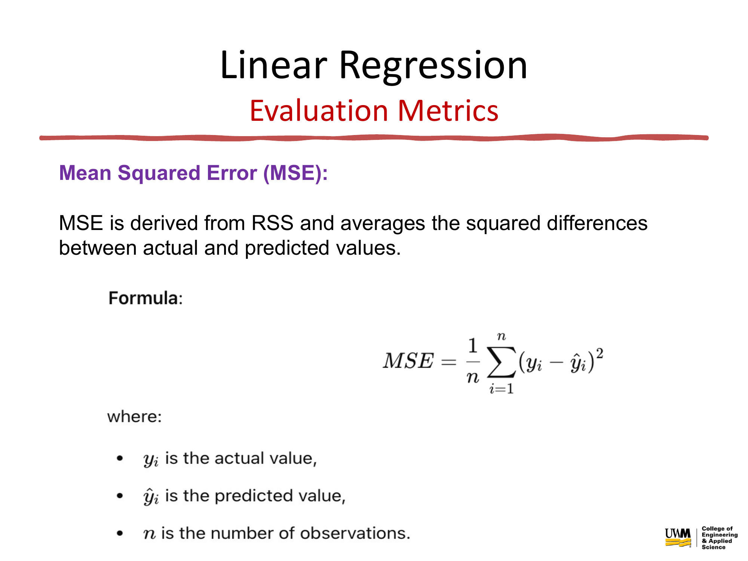



Slide 26
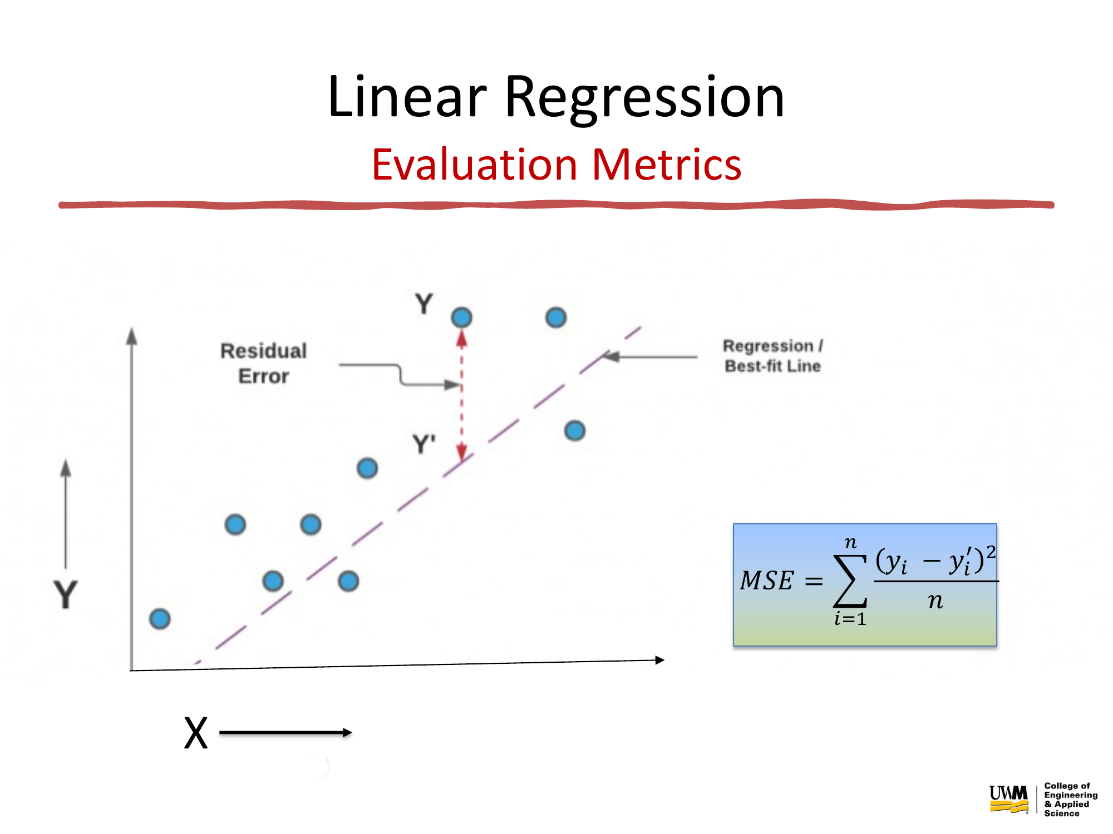




Slide 27
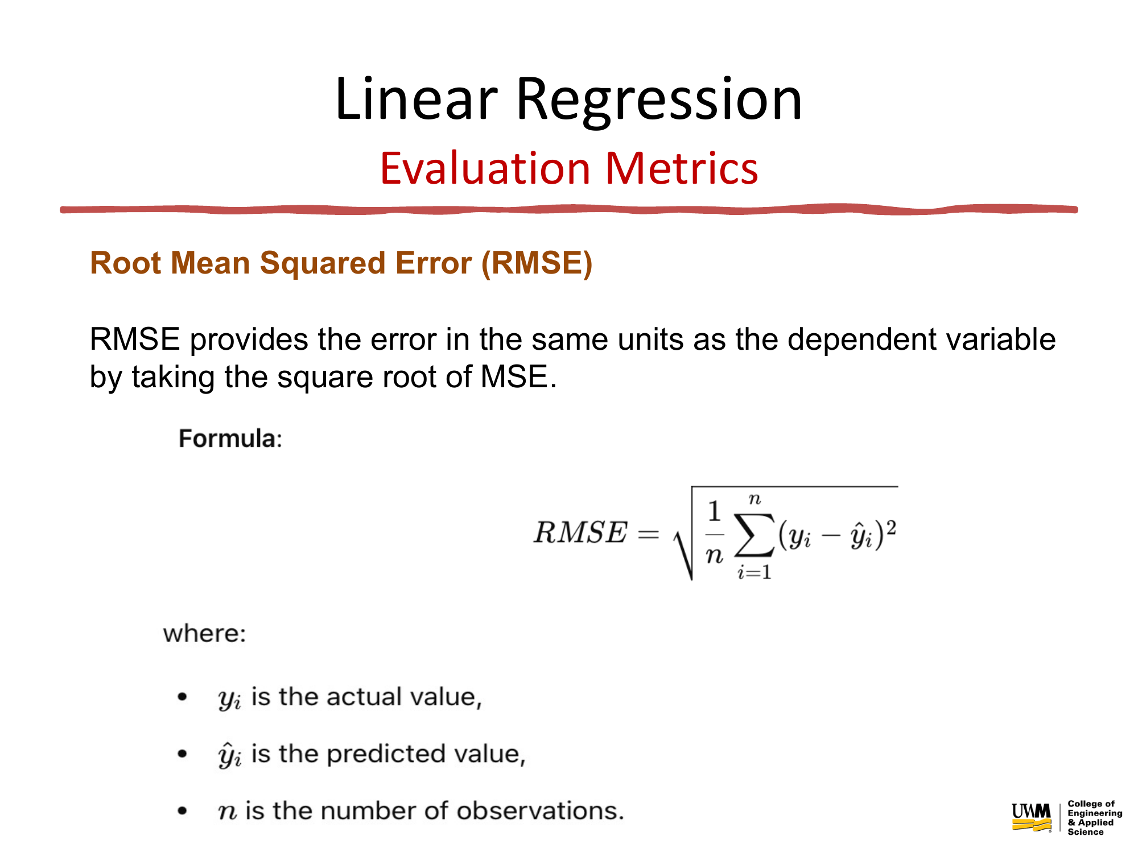



Slide 28
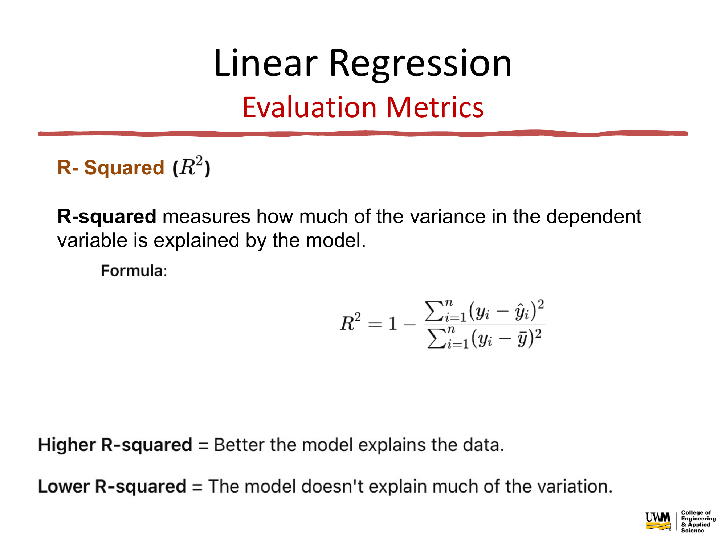


Slide 29
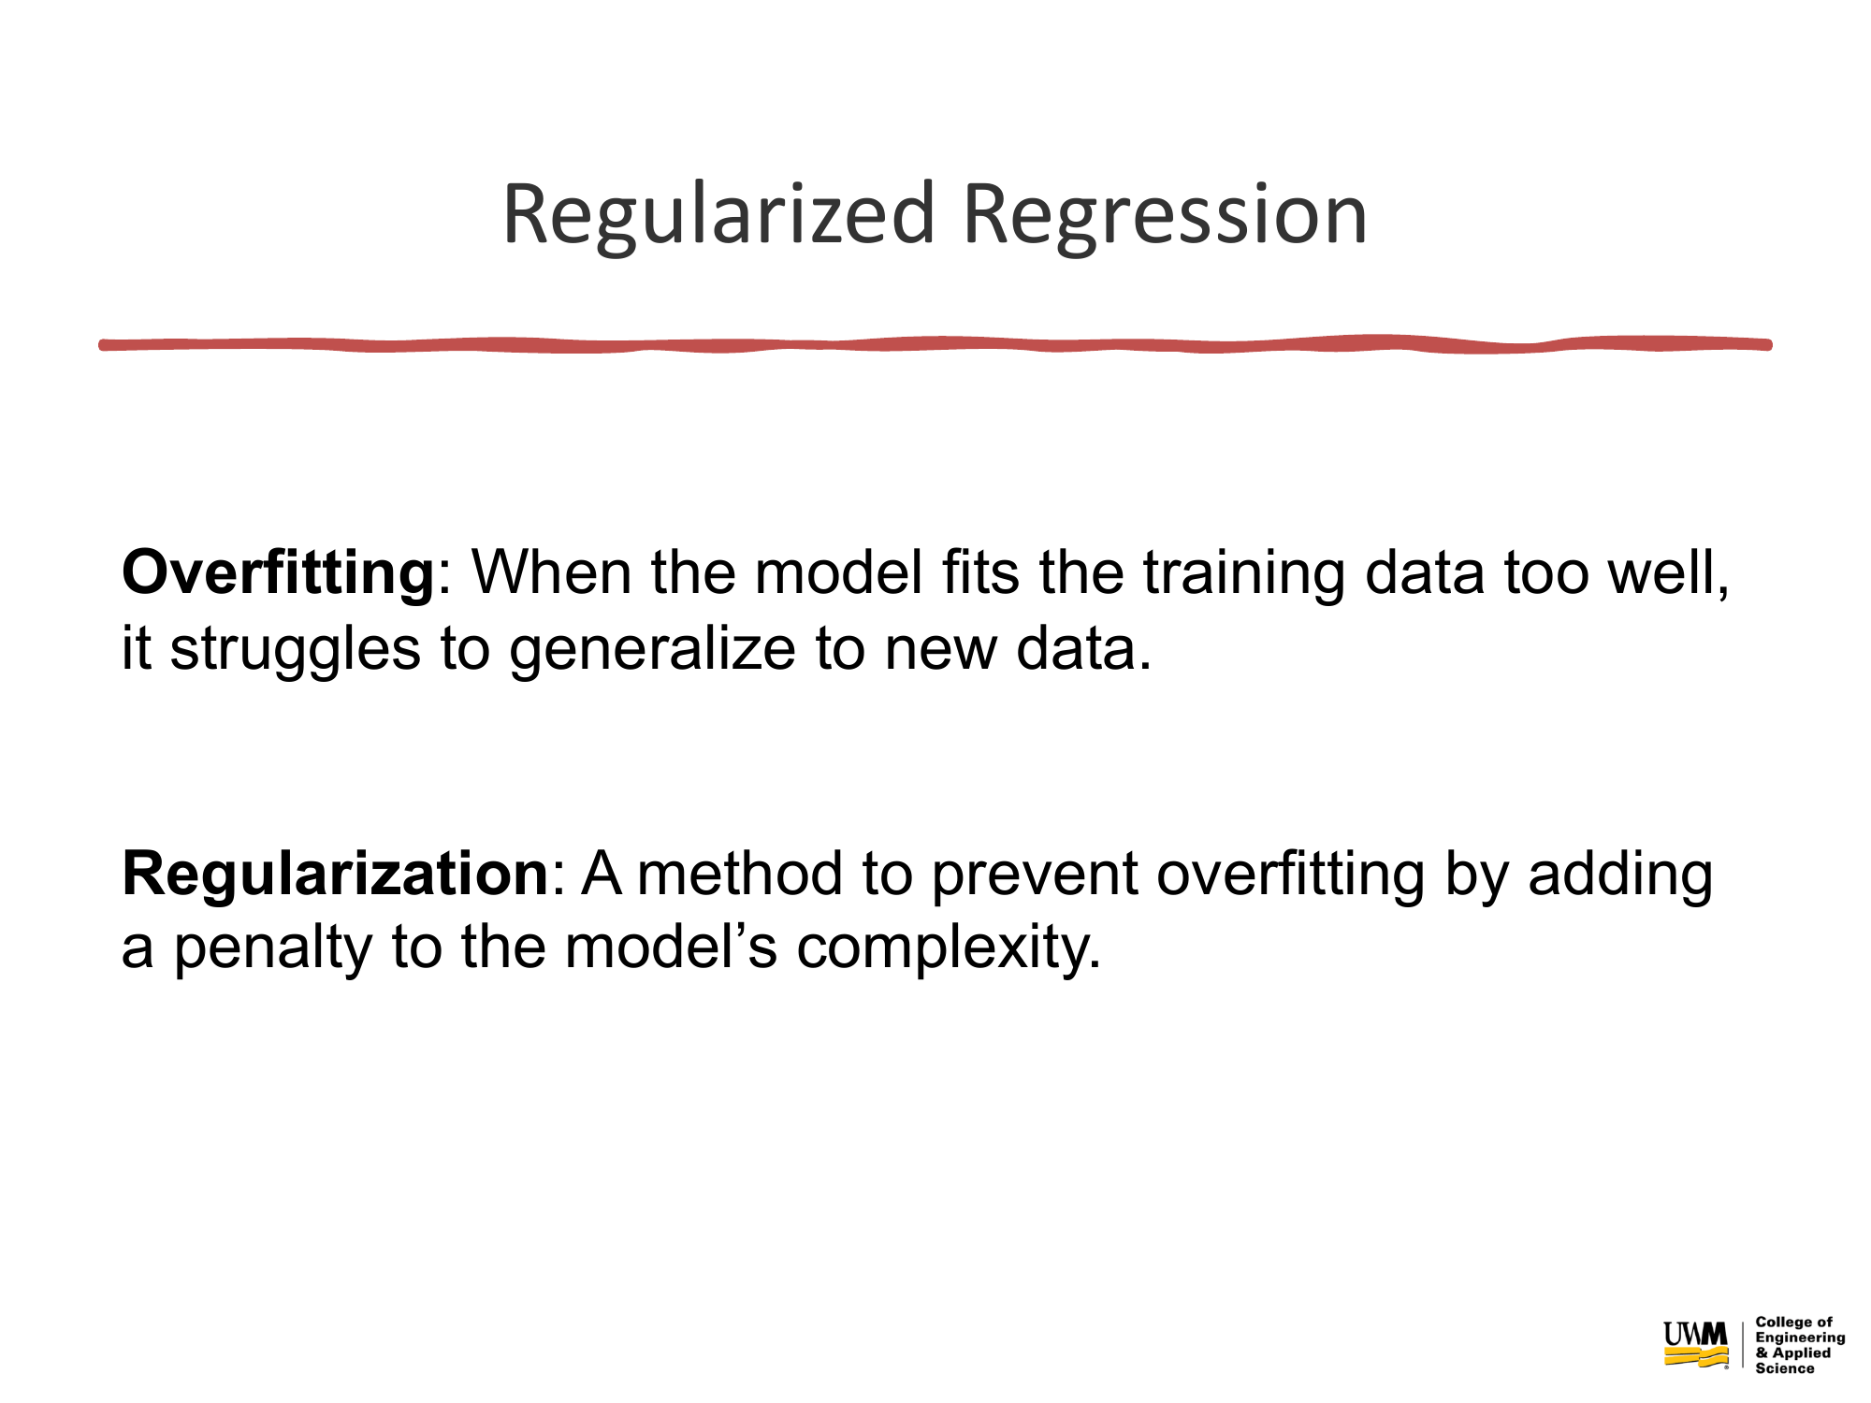


Slide 30
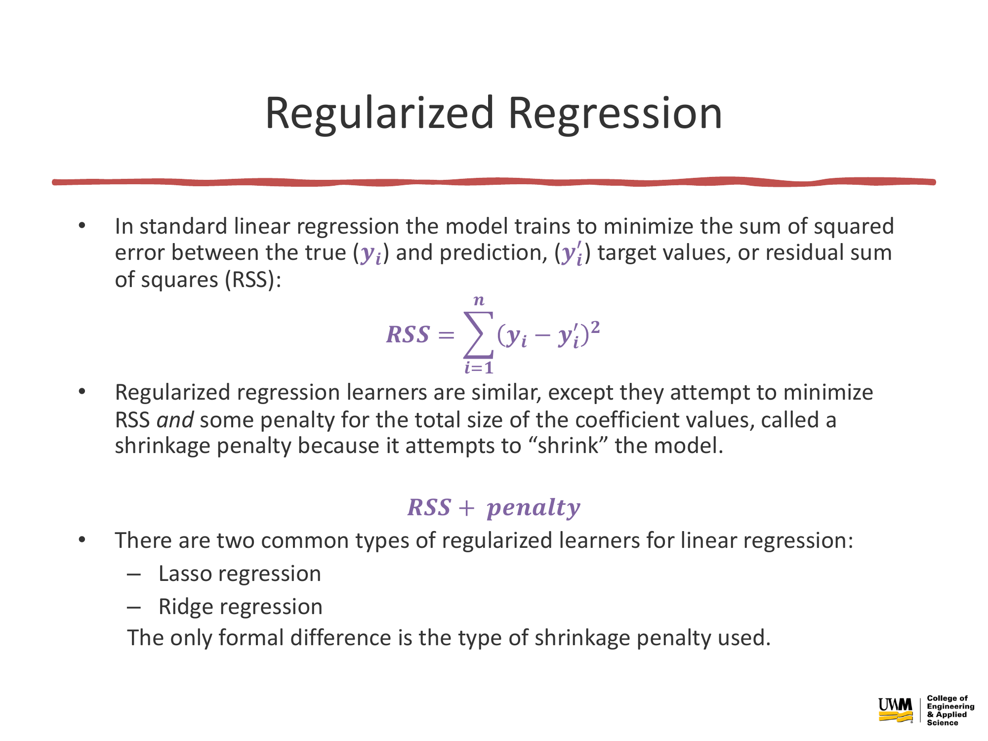

Slide 31
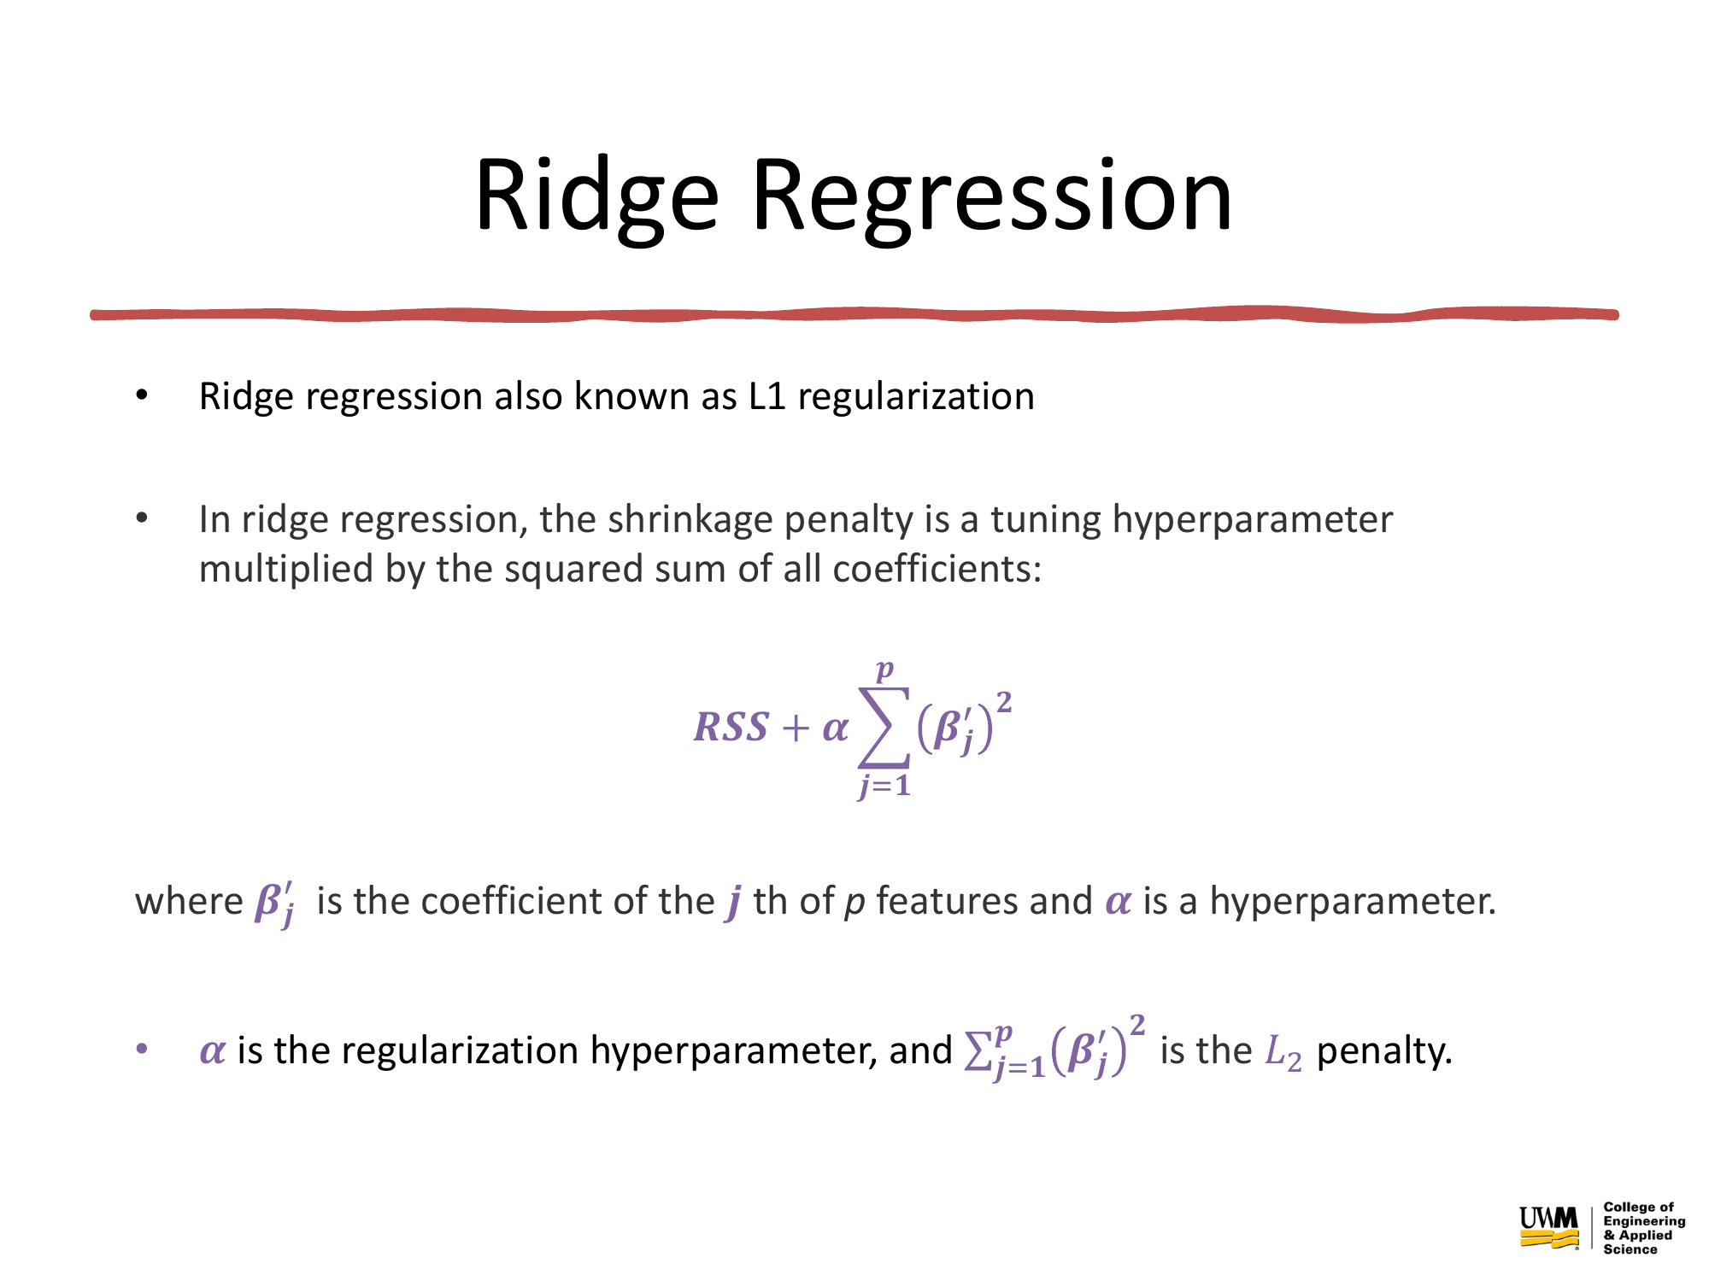

Slide 32
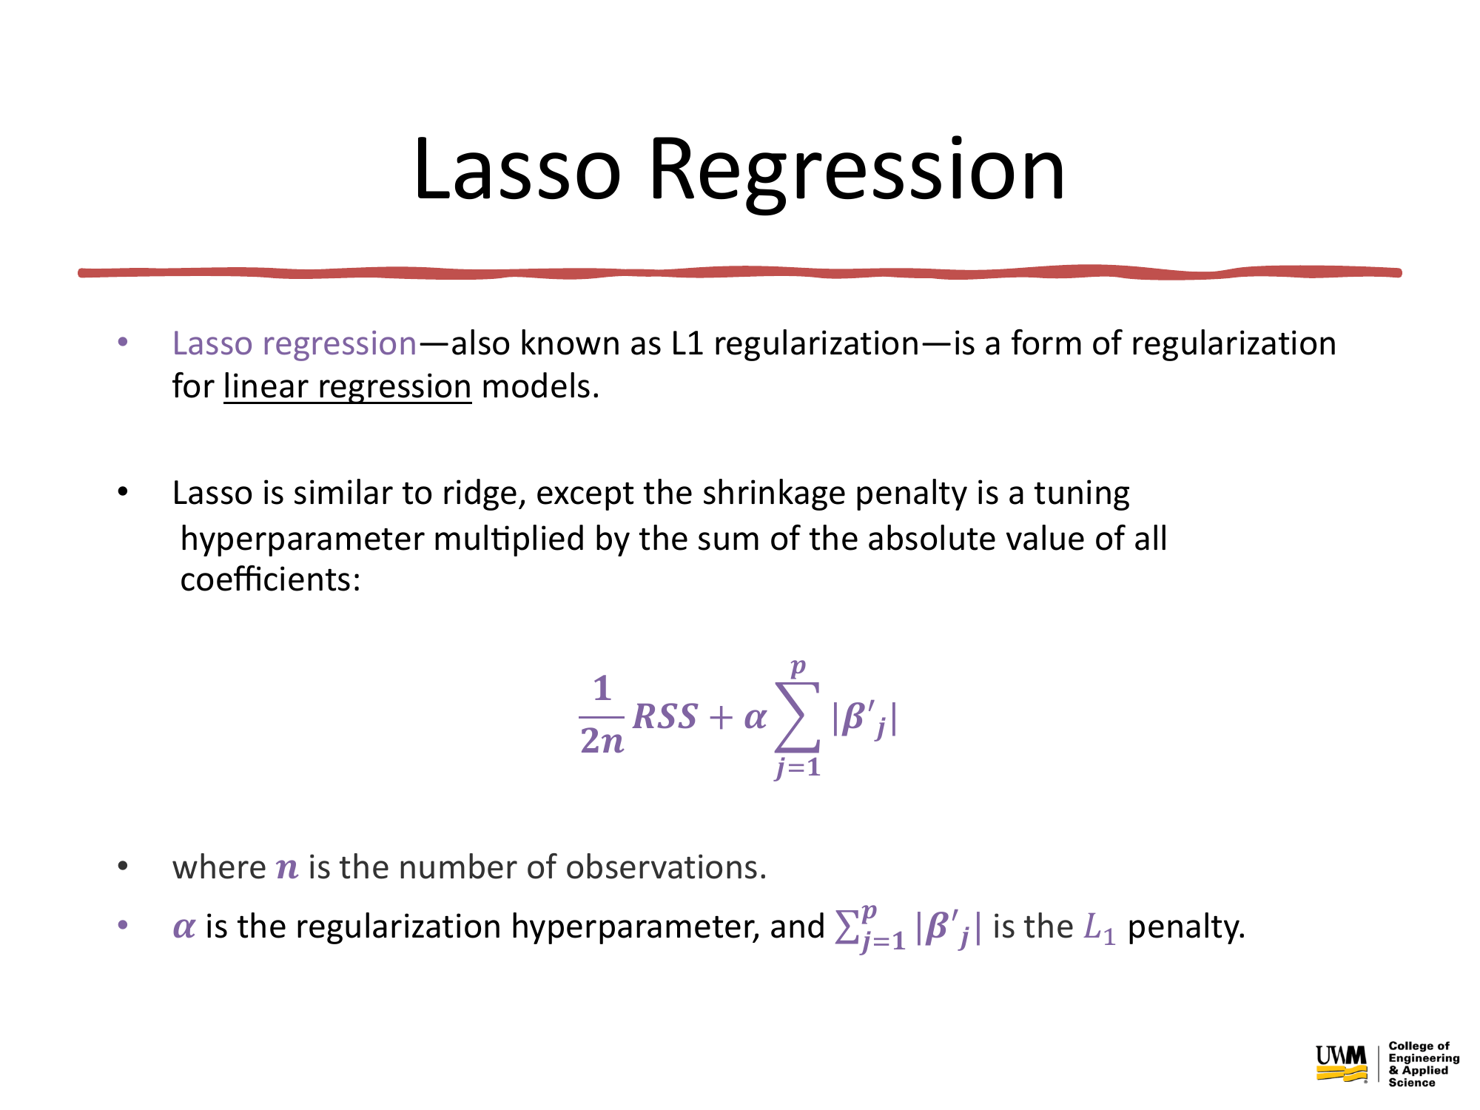

Slide 33
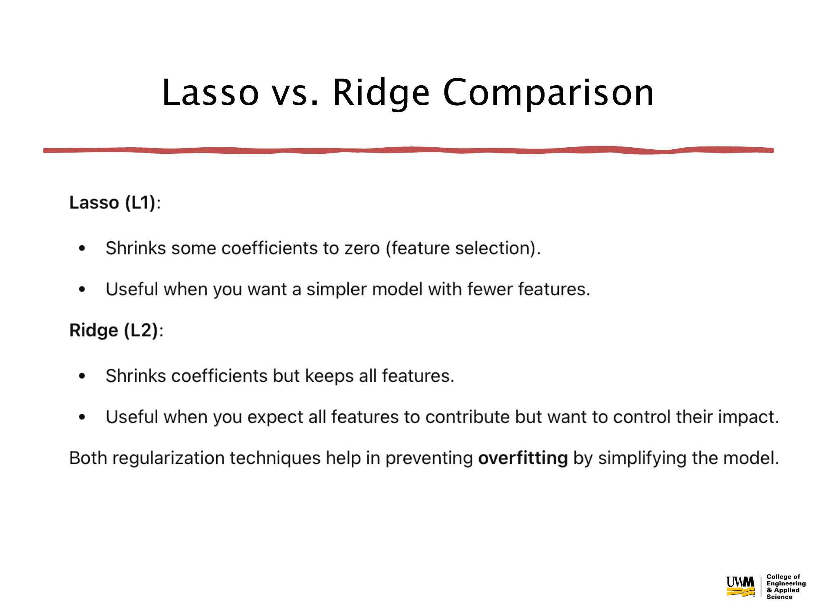

Slide 34
Linear Regression from Scratch
Generate your own synthetic dataset
Use the normal equation to compute the regression line
Plot your predictions vs actual data
Evaluate with MSE and R²
Modify coefficients, add noise, and explore effects!

Slide 35
Next Up: Hands-On Regression Notebook
Train and compare regularized regression models:
Lasso Regression (L1 penalty)
Ridge Regression (L2 penalty)
Use cross-validation to evaluate performance robustly
Apply grid search to tune hyperparameters and find the best model

